Slide 1
Which Class Should You Take?
Final Project
Joshua Michael Dillon
Yue Shen Gu
Eric Ming-Yin Ho
Schinria Rema Islam
Qianyun Zhang

Slide 2


Slide 3
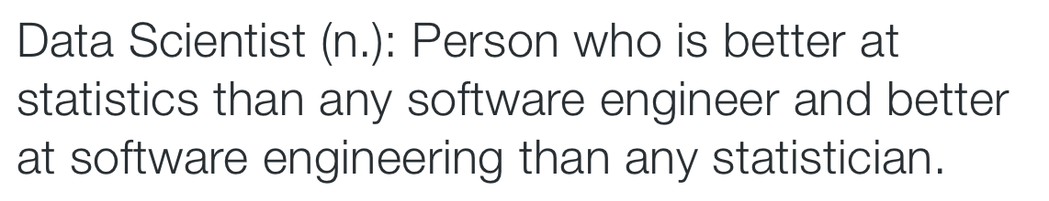

Slide 4
we want to help you build these skills

Slide 5
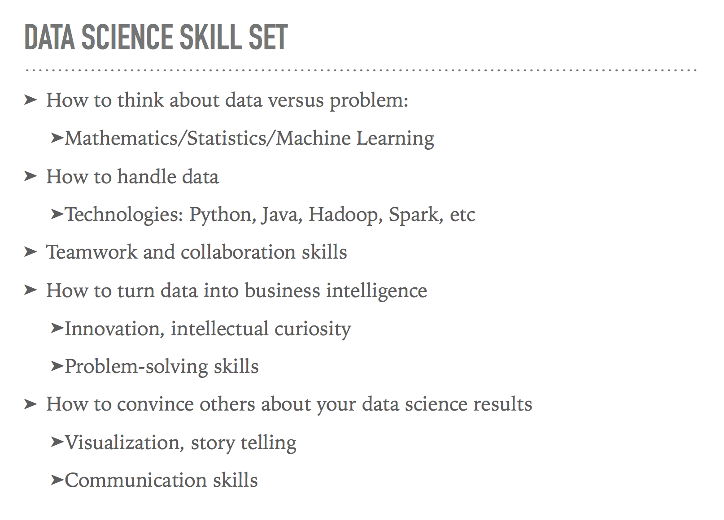

Slide 7
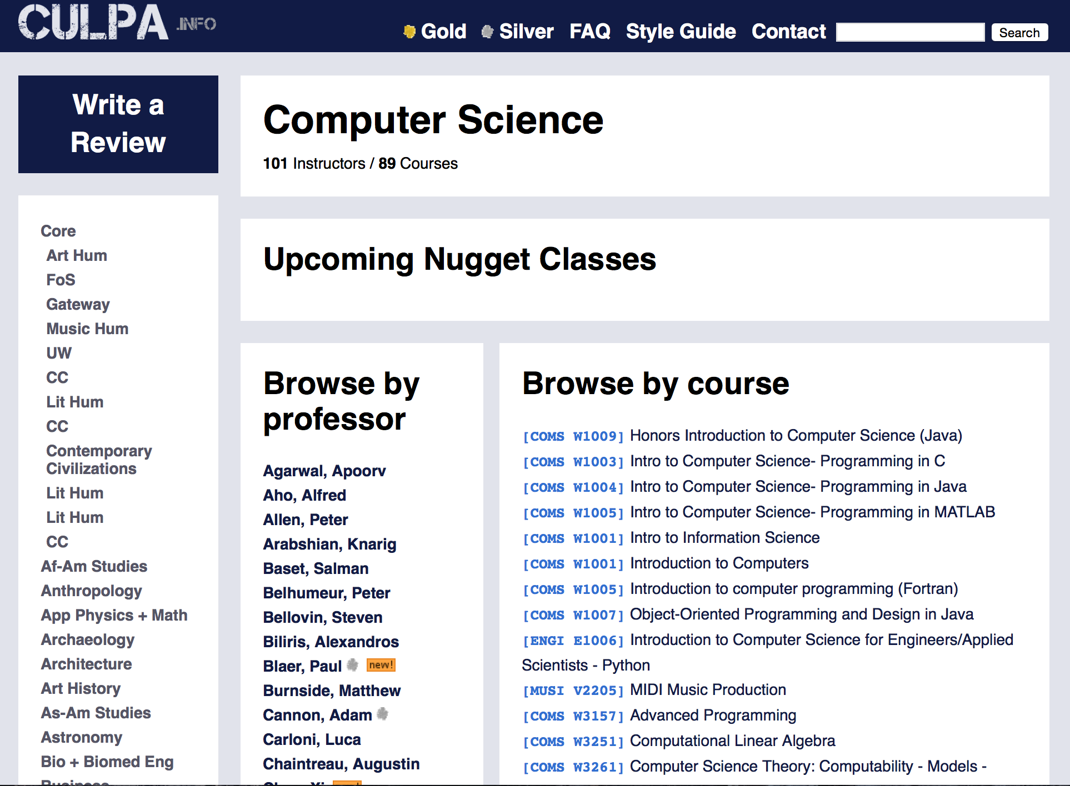

Slide 8
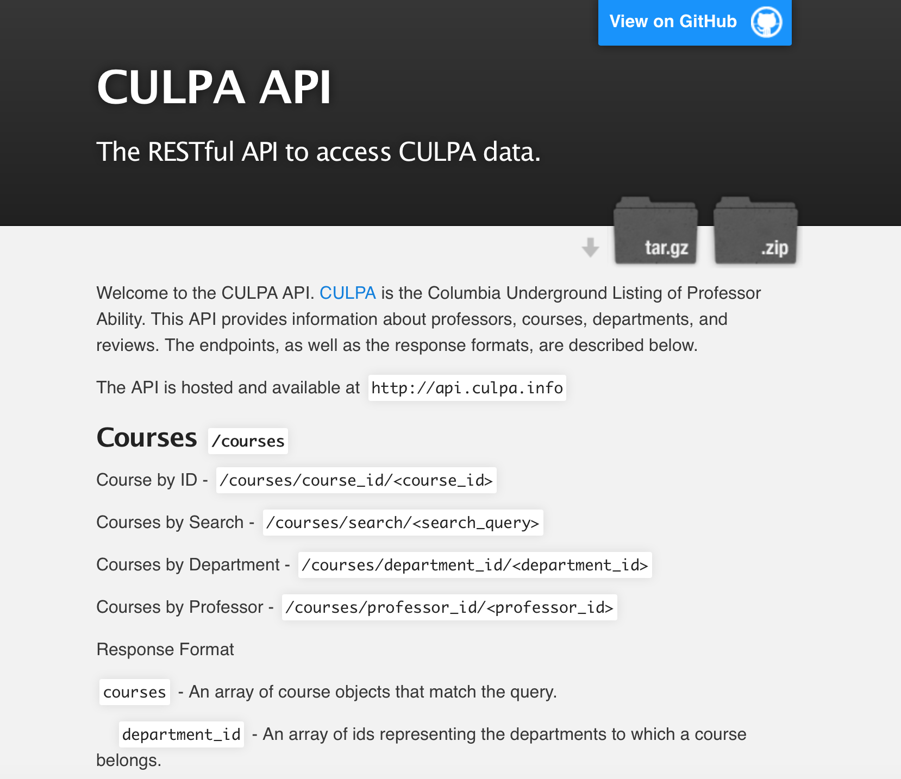

Slide 9

Introducing….

